Slide 1

DETERMINERS
CLASS IX

Slide 2
1. Determiners: ‘Determiner’ is a word used before a noun to indicate which things or people we are talking about. The words ‘a’, ‘the’, ‘my’, ‘this’, ‘some’, ‘many’, etc. are called determiners:
• He is a good boy.
• The boy you met is my friend.
• This novel is very interesting.
• I have some information about the accident.
• There were many people at the station.
All the italicised words are determiners and they limit the meaning of the nouns that follow them.

Slide 3
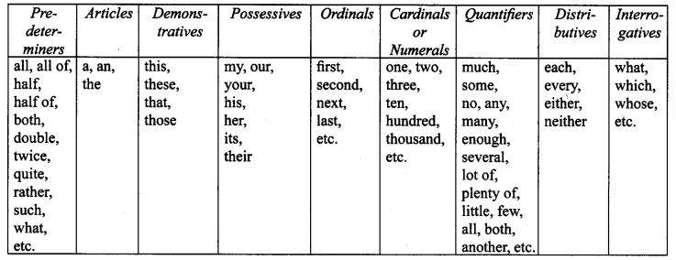
2. Kinds of Determiners:

Slide 4
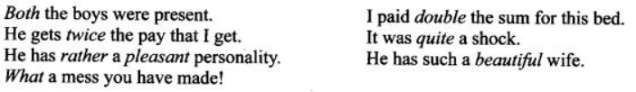
3. Pre-determiners:Pre-determiners are the words which occur before a determiner to limit the meaning of a noun:
4. Articles:The article system in English consists of the definite article ‘the’ and the indefinite article ‘a’ or ‘an'.We can think of nouns in a specific or general way. When we refer to particular people or things or something that has already been mentioned or can be understood, we use the definite article ‘the’. When we refer to singular nouns for the first time, or refer to things in a general way, we use the indefinite article ‘a’ or ‘an’.

Slide 5
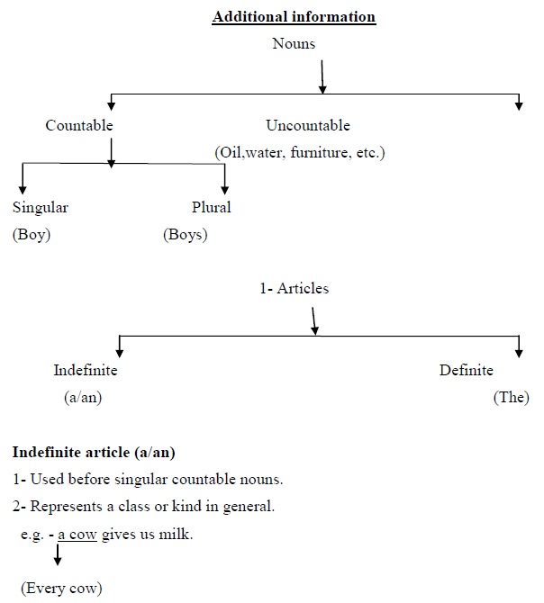
A- Used before singular countable nouns beginning with consonant sound.
Example- a one-eyed man, a unique place, a European, a University, a Mango etc.
An– Used before singular countable nouns beginning with vowel sound.
Example- an Indian, an hour, an umbrella, an honest boy (Mute ‗h‘)
Definite article (the) – Used before both countable and uncountable nouns.
Usage:-
1- When we talk about something for the second time in the same context or anything qualified by a phrase.

Slide 6
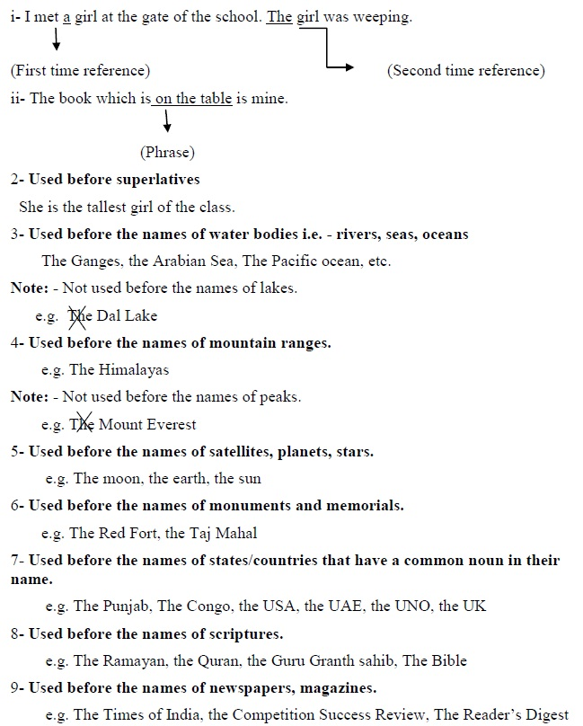

Slide 8
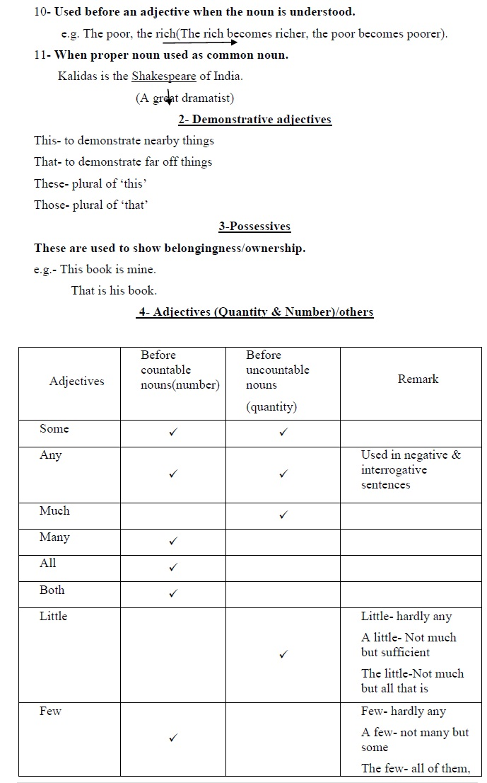
5. Demonstratives: This, These, That, Those
The demonstrative determiners are used to talk about persons or things that have already been mentioned.
This and These refer to the things that are near and can be seen. ‘That’ and ‘Those’ are used to refer to the things that are at a distance but can be seen.
• We lived in this house for four years.
• She bought these books.
• Those boys are very mischievous.
• I like this school.
• I met her this week.
‘

Slide 9
This’ and ‘that’ are used for singular nouns and ‘‘these’’ and ‘those’ for plural nouns.
• Can you lift that box?
• Would you like to buy those books?
• These boys have done their work.
• I have already met that man.
6. Possessives: My, our, your, his, her, its, their. The possessives are used to show possession.
• He is my uncle.
• Our neighbour is a rich man.
• Your daughter is beautiful.
• What is her age?
• What is his name?
• Do you know its value?
• Their house is very big.
7. Ordinals: first, second, next, last, etc.
• The ordinals show what position something has in a series:
• He is the first boy who has joined this school.
• I shall meet him the next week.
• He is the last man to help you.

Slide 10
8. Cardinals: one, two, three, hundred, etc.Cardinals are ordinary numbers like one, two, three, etc. They show how many of something there are:
• There were only ten boys in the class.
• She lived for eighty years.
• He has two daughters.
• I met three young men at the station.
• He balanced himself on one foot.
9. Quantifiers: much, some, several, a lot of, both, all, etc.The quantifiers refer to the quantity of things or amount of something.
• There were some people at the airport.
• Plenty of people would like to have your job.
• They didn’t make much progress.
• There is no milk in the bottle.
• There is enough powder in the can.
• I have forgotten some of the details.
• They had enough guests already.
• All children enjoyed the show.
• There was little water in the jug.
• It has not made any difference to me. He drank a lot of water.

Slide 11
10. Distributives: each, every, either, neither.
Distributive determiners refer to each single member of a group.
• Each is used when we talk about the members of a group individually and every when we make a general statement. Both are followed by a singular countable noun:He met each guest. The minister visited every flood-affected area.I agree with every word he says. Each request will be considered.
Either is used to talk about two things, but usually indicates that only one of the two is involved.Either of the two girls should come here.
• Neither is the negative of Neither member came to attend the meeting.
• Either can also mean People stood in either side (both sides) of the road. Neither is followed by a singular noun.
• Neither boy said anything.Neither answer is correct.
11. Interrogatives: what, which, whose, etc.
The interrogative determiners are used for asking questions:
• What subjects are you studying?Which colour do you like the most?Whose house is this?

Slide 12
Exercise
Q1.Fill in the blanks with suitable determiners.
(i)……………. books are missing from the library. (Any, Some)
(ii) She has not solved…………….. sums, (many, any)
(iii) This book is mine but………………. is yours, (that, any)
(iv)........... boys have done their work. (That, These)
(v) He didn’t make………… progress, (much, many)
(vi) He has forgotten……………….. of the details, (some, many)
(vii) The District Magistrate visited…………………….. flood affected area, (every, either)
(viii)………….. villa is this? (Whose, What)
(ix) He is the…………. boy who has joined this gym. (first, whose)
(x) I met her………… week, (this, those)

Slide 13
Q2.Fill in the blanks with suitable determiners.
(i) Does your cow give…………………………….. milk? (much, many)
(ii) Ramesh bought……………………….. ice-cream for the family, (some, many)
(iii) Good manners are needed………………………….. where, (every, each)
(iv) The calves were grazing in the field with…………… mothers for many years, (that, their)
(v) ………………. answer is correct. (Neither, Either)
(vi) I shall meet him ………………………. week, (next, last)
(vii) Did you see…………………………… persons at the dinner? (much, many)
(viii) I have watched……………………………. movie of late B.R. Chopra, (every, many)
(ix) ………………….shop should we go in? (Which, Whose)
(x) Given me…………………….. advice on how to improve my writing skills, (some, many)

Slide 14
Q3.Fill in the blanks with suitable determiners:
1) ________ house is not mine.
2) I have ________ more files to complete.
3) She doesn’t like him ________.
4) Nidhi answered ________ the questions wrong.
5) ________ the girls had to carry their own luggage.
6) I shall not buy ________ oranges. These are rotten.
7) I have bought ________ cycle.
8) I drive 10 Kms ________ day to reach my school.
9) We are expecting ________ guests tonight.
10) ________ of my answers were correct. So I passed.
11) Hello! ________is Nipun. Can I speak to Aman?
12) He spends ________ time on video games.
13) What is your sister doing ________ days?
14) I can speak ________ Hindi.
15) He had built ________ unique house.

